Slide 1
Git-lab 简单使用教程

Slide 2



Introduction
Git is a distributed version control system, which means you can work locally but you can also share or "push" your changes to other servers.
Protocols: HTTPS / SSH
Notes:
Semantic segmentation: detect and classify

Slide 3
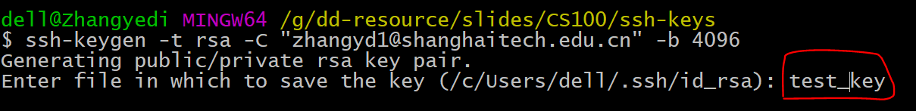
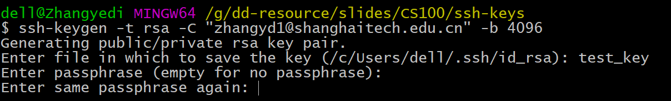
SSH配置
Git Generate your SSH-key
$ ssh-keygen -t rsa -C "your.email@example.com" -b 4096
Notes:
Semantic segmentation: detect and classify

Slide 4
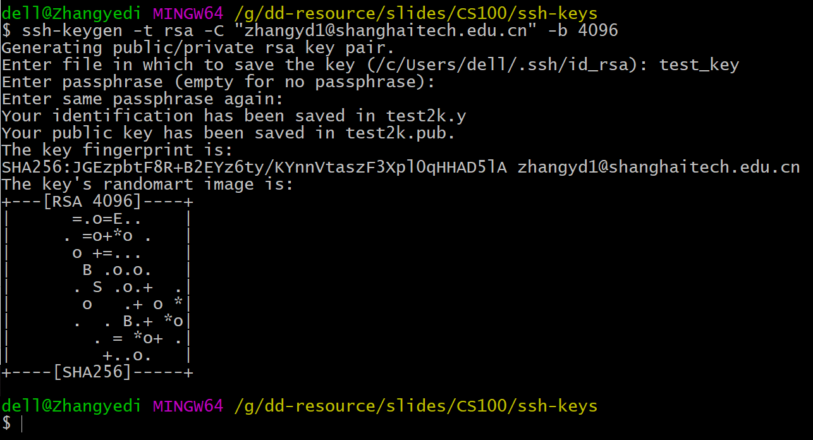

Slide 5
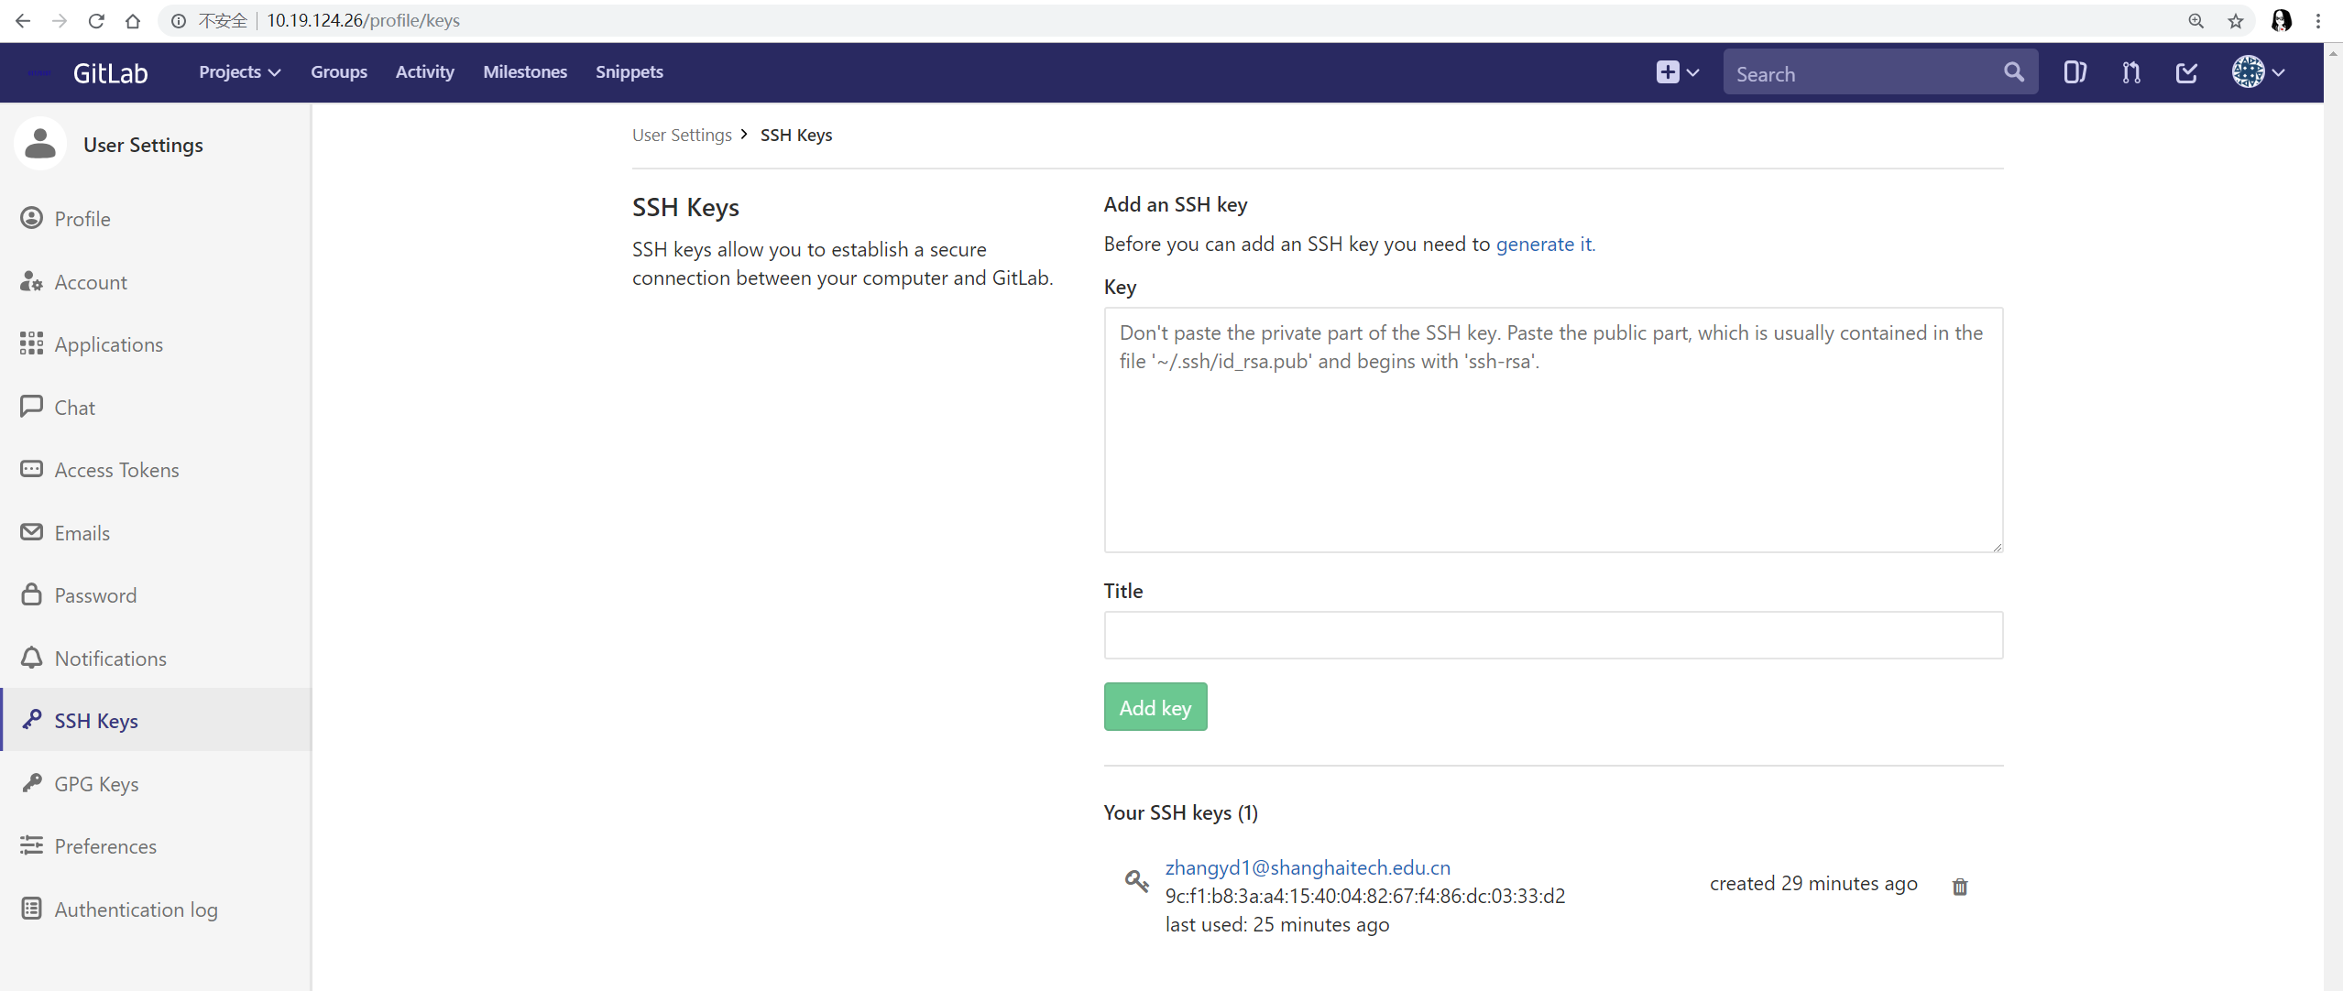
SSH配置
Add SSH-key to your GitLab account
右上角个人属性 -- settings -- SSH Keys
Notes:
Semantic segmentation: detect and classify

Slide 6
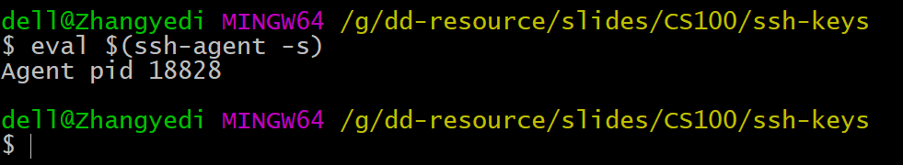
SSH配置
2. Add SSH-key to ssh-agent (本地)
# start the ssh-agent in the background
$ eval $(ssh-agent -s)
Notes:
Semantic segmentation: detect and classify

Slide 7
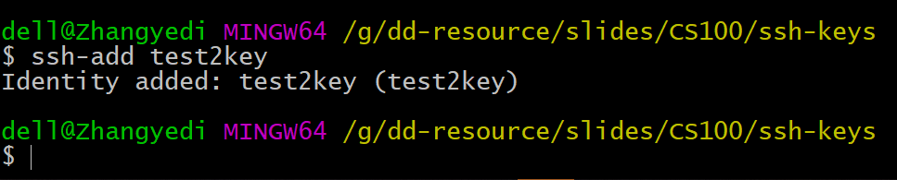
SSH配置
2. Add SSH-key to ssh-agent (本地)
# give SSH-key to ssh-agent
$ ssh-add your-ssh-key
Notes:
Semantic segmentation: detect and classify

Slide 8
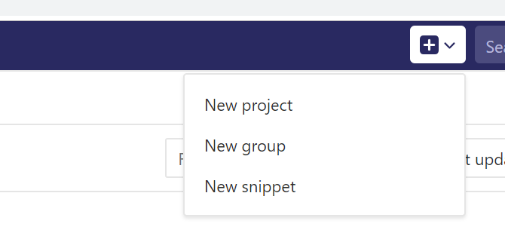
Basic operations
1. Create a private project for testing
Notes:
Semantic segmentation: detect and classify

Slide 9
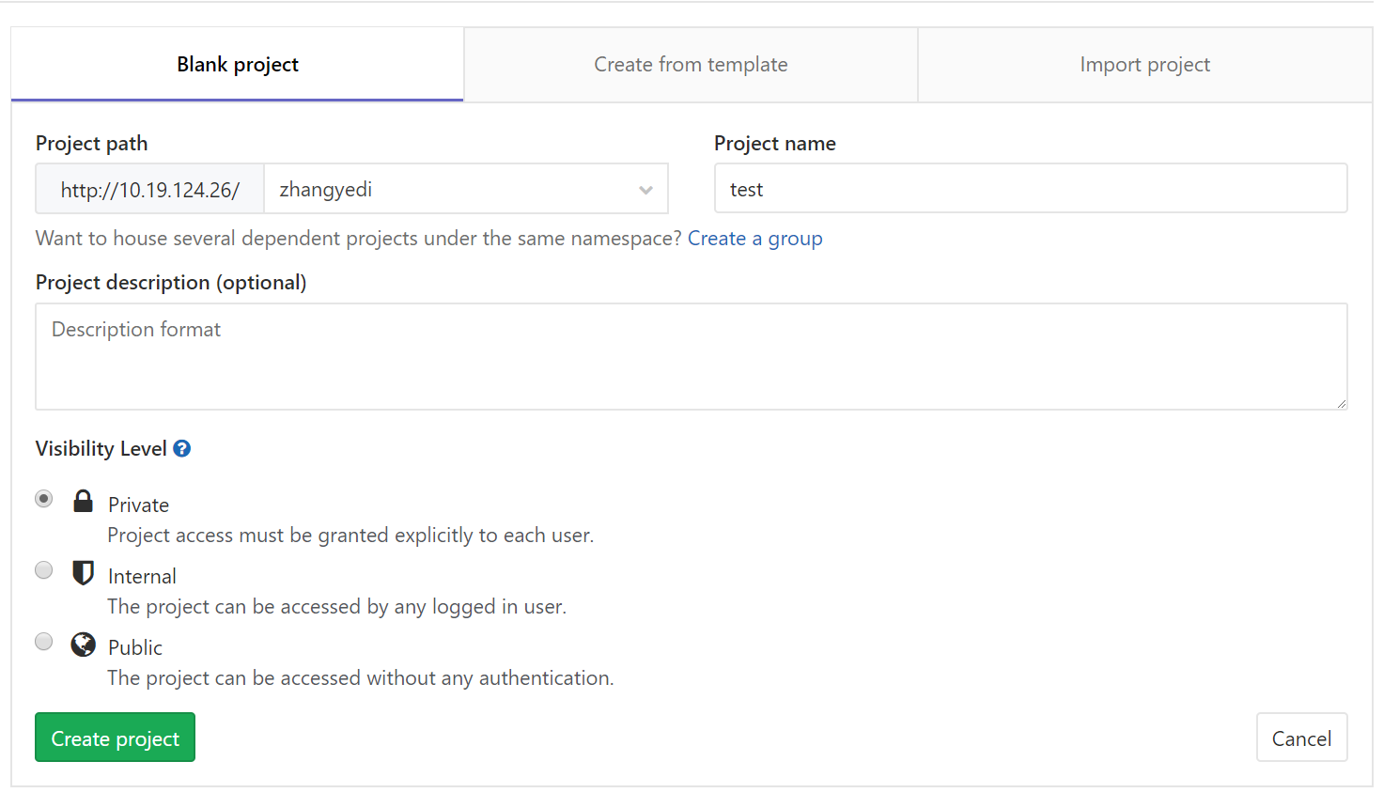
Basic operations
1. Create a private project for testing
Notes:
Semantic segmentation: detect and classify

Slide 10


Basic operations
2. Test: submit local file to GitLab
Notes:
Semantic segmentation: detect and classify

Slide 11
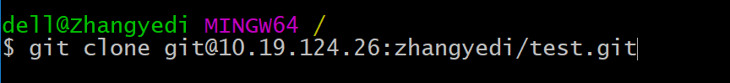
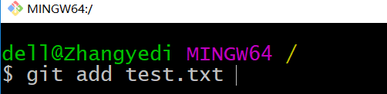


Basic operations
2. Test: submit local file to GitLab
Notes:
Semantic segmentation: detect and classify

Slide 12
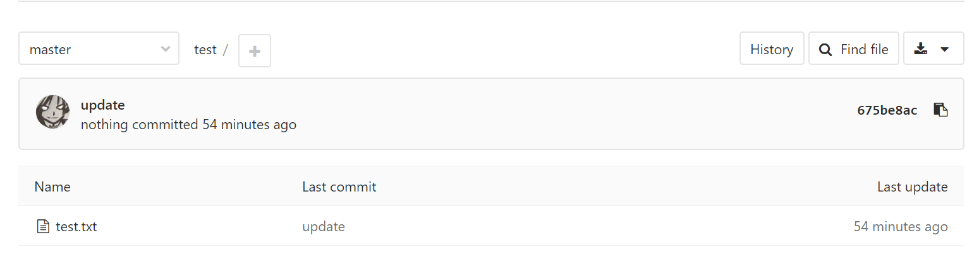
Basic operations
2. Test: submit local file to GitLab
Notes:
Semantic segmentation: detect and classify

